Slide 1
MENTOR CONNECT
PIP2001 Capstone Project
Review-2
Batch Number: CBD-G12
Under the Supervision of,
Dr. SRINIVAS T R
Professor
School of Computer Science and Engineering
Presidency University
Roll Number 20211CBD0007 20211CBD0014 20211CBD0053 20211CBD0054 | Student Name CHITRIKA. M ANUPAMA ATHMAKURU DEEPTHI KALLA SEETHA THANOOJA
Name of the Program: B tech(Big Data)
Name of the HoD: Dr. Pravinthraja
Name of the Program Project Coordinator: suma NG
Name of the School Project Coordinators: Dr. Sampath A K / Dr. Abdul Khadar A / Mr. Md Ziaur Rahman

Slide 2
Content
Problem Statement
Github Link
Analysis of Problem Statement
Timeline of the Project
References

Slide 3
Problem Statement Number:
Organization : MENTOR CONNECT
Category (Hardware / Software / Both) : Software
Problem Description: The best way Mentoring during the Career/Education is a vital aspect for success of a candidate and this can achieve amazingly positive changes in the life of a mentee. Today , India is known due to its demographic advantage and career directions are infinite. However newer directions are demanding candidates to be coached and mentored for progress. This application or platform can be developed by students understanding this knowledge development need and bring together mentor and mentees.
Difficulty Level: Complicated

Slide 4
LITERATURE REVIEW
Sl.no. | Paper Title | Proposed Model | Results | Drawbacks
1. | Post Covid Scenario Effective E-Mentoring System in Higher Education(2023) | Development of a web-based e-mentoring application to facilitate communication between university students and mentors, focusing on matching, interaction, and support in a post-pandemic educational environment. | • Enhanced mentor-mentee engagement, improved academic performance, and better adaptation to online learning modalities. • | Challenges may include ensuring data privacy, user adoption resistance, and maintaining effective communication in a virtual setting.
2 | FREEDM ERC Precollege Programs: Motivating Careers in the Electric Power Industry" by Holbert et al. (2020) | Implementation of precollege programs, including teacher workshops, student research experiences, and renewable energy camps, to engage middle and high school students in STEM, particularly in electric power engineering. | Increased interest and enrollment in STEM fields among precollege students, with a focus on diversifying the future workforce in the electric power industry. | Potential challenges include sustaining long-term student interest, securing continuous funding, and effectively measuring program impact.

Slide 5
3 | Mentoring in Lower-Level Engineering Courses" by Vasquez et al. (2024) | Integration of mentoring components into lower-level engineering courses to support student learning and retention, possibly through peer mentoring or faculty-student interactions. | Improved student understanding of course material, increased retention rates in engineering programs, and enhanced sense of community among student | Challenges may involve resource allocation for mentoring programs, ensuring mentor quality, and balancing mentoring activities with academic workloads.
4 | Work-in-Progress: Emergent Themes from 'High Impact' Role Model and Mentor Narratives" by Trenshaw et al. (2023) | Qualitative analysis of narratives from impactful role models and mentors to identify themes that contribute to effective mentoring in engineering education. | Identification of key characteristics and practices of successful mentors, providing insights for developing effective mentoring programs. | Limitations may include subjective interpretations of narratives and the challenge of generalizing findings across diverse educational contexts.

Slide 6
5 | Peer-Mentoring in Design Projects in Project-Based Learning (PBL) at First-Year Engineering Course" by Gadad et al. (2022) | Implementation of peer-mentoring structures within project-based learning environments for first-year engineering students, facilitating collaborative learning and skill development. | Enhanced student engagement, improved problem-solving skills, and smoother transition into engineering education. | Potential issues include varying mentor competencies, possible dependency on peers, and the need for effective oversight to ensure positive outcomes.
6 | A Web Platform to Support Mentoring Programs in Higher Education" by Andrade et al. (2024) | Development of a web-based platform designed to facilitate and manage mentoring relationships in higher education, incorporating features like matching algorithms, communication tools, and progress tracking | Streamlined mentor-mentee matching process, improved accessibility to mentoring resources, and enhanced tracking of mentee progress | Challenges may include ensuring user engagement, maintaining data security, and providing technical support for platform users.

Slide 7
7 | Study by Hafiz Iqbal (2024) | While specific details are unavailable, the study likely explores educational strategies or interventions, possibly focusing on mentoring or instructional methods. | Insights into effective educational practices, potentially leading to improved teaching methodologies or student outcomes. | Without specific information, potential limitations could involve contextual applicability and the need for empirical validation.
8 | Exploring E-Mentoring: Co-Designing & Un-Platforming" by Alhadlaq et al. (2019) | Investigation of e-mentoring practices through co-design sessions with stakeholders, aiming to develop flexible mentoring approaches beyond traditional platforms. | Development of adaptable e-mentoring models that cater to diverse needs and contexts, fostering more personalized mentoring experiences. | Challenges may include coordinating co-design efforts, ensuring scalability of un-platformed solutions, and addressing technological barriers.

Slide 8
9 | Building and Sustaining Mentor Interactions as a Mentee" by Sarabipour et al. (2022) | Examination of strategies for mentees to effectively initiate and maintain mentoring relationships, possibly through surveys or interviews with successful mentees. | Identification of best practices for mentees, leading to more fruitful and sustained mentoring interactions. | Potential limitations include the variability of mentor availability and the mentee's ability to implement suggested strategies effectively.
10 | Online Mentoring: Programs and Practices" by Susan S. de Janusz and Shelley D. Godshalk(2023) | Comprehensive review of various online mentoring programs and practices, analyzing their structures, outcomes, and impacts on professional development. | Compilation of effective online mentoring models and identification of key factors contributing to successful mentoring relationships in virtual environments. • | Challenges discussed may include technological limitations, maintaining engagement in online settings, and ensuring the quality of mentor-mentee interactions.

Slide 9
Github Link
https://github.com/chitrika003/mentor_connect.git

Slide 10
Analysis of Problem Statement
Technology Stack Components:
Front –End:React.js
Back-End: Node.js
Database: MongoDB
File Storage: Google Cloud Storage/AWS S3
Version Control : Git(GitHub)

Slide 11
Analysis of Problem Statement (contd...)
Software and Hardware Requirements:
System: operating system
Integrated Development Environment: Visual Studio code
Front-End Operating Development: Node.js, npm, Browser
Version Control : GitHub
Hardware : Processor(i5 or AMD Ryzen5 or above) ,RAM(8GB or above)

Slide 12
Analysis of Problem Statement (contd...)
Difficulty in scheduling meetings between mentors and mentees. Inefficient communication due to lack of proper tools for interaction. Lack of structured guidance on career growth, skill enhancement, and industry trends.
Scheduling Issues: Difficulty in finding and booking suitable time slots with mentors.
Limited Interaction Modes: No integrated platform that offers seamless video, chat, and resource-sharing functionalities. Security Concerns: Ensuring that interactions remain private and professional.
Scalability: The platform must handle a growing number of users efficiently.
Personalization: Mentees need mentors who align with their career goals and interests.

Slide 13
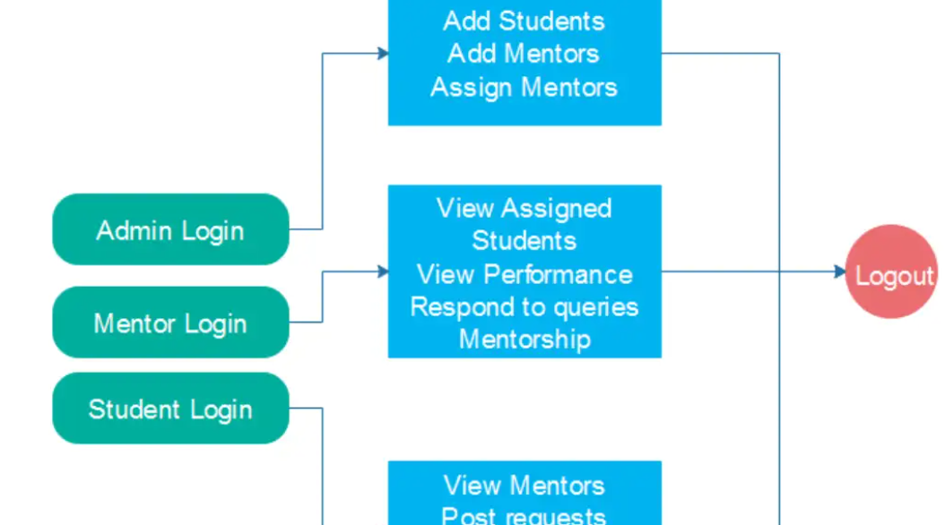
ARCHITECTURE DIAGRAM

Slide 14
MODULES
1. User Management Module
Secure user authentication & role-based access (OAuth, JWT). Profile creation with mentee/mentor details (bio, expertise, availability). Mentor-mentee pairing
2. Video Conferencing & Chat Module
Live video calls (WebRTC, Zoom API, or Jitsi). Real-time chat messaging (Firebase/Twilio).
File sharing for study materials, notes, or assignments.
3. Attendance Tracking & Monitoring Module
Mentees log attendance via the platform. If attendance falls below 75%, an alert is sent to the mentor. Attendance history stored in the database for tracking & reports.

Slide 15
4. Automated Scheduling & Appointment Module
Calendar integration (Google Calendar API) for scheduling. Automated meeting booking based on mentor availability. Reminder notifications for upcoming sessions.
5. Dashboard & Analytics Module
Mentors view mentee progress, attendance, and session reports. Admins monitor overall platform engagement & statistics.
6. Notification & Alerts Module
Email/SMS notifications for session reminders and attendance alerts. Instant chat notifications for new messages.

Slide 16
Algorithm
Logout Algorithm
Authentication Algorithm
Password Algorithm
Sorting Algorithm
Search Algorithm

Slide 17
Timeline of the Project (Gantt Chart)
Weeks 1-2: Planning
Weeks 3-6: Initial development, including front-end setup, back-end setup, and product form design.
Weeks 7-10: Implement dashboard, complete back-end API for managing products and events, integrate payments, and complete database interaction.
Weeks 11-13: Complete testing for both front-end and back-end and prepare for deployment.
Week 14: Deployment of the application to a cloud provider (AWS, Heroku, etc.).
Weeks 15-16: Post-deployment monitoring, debugging, and ongoing support.

Slide 18
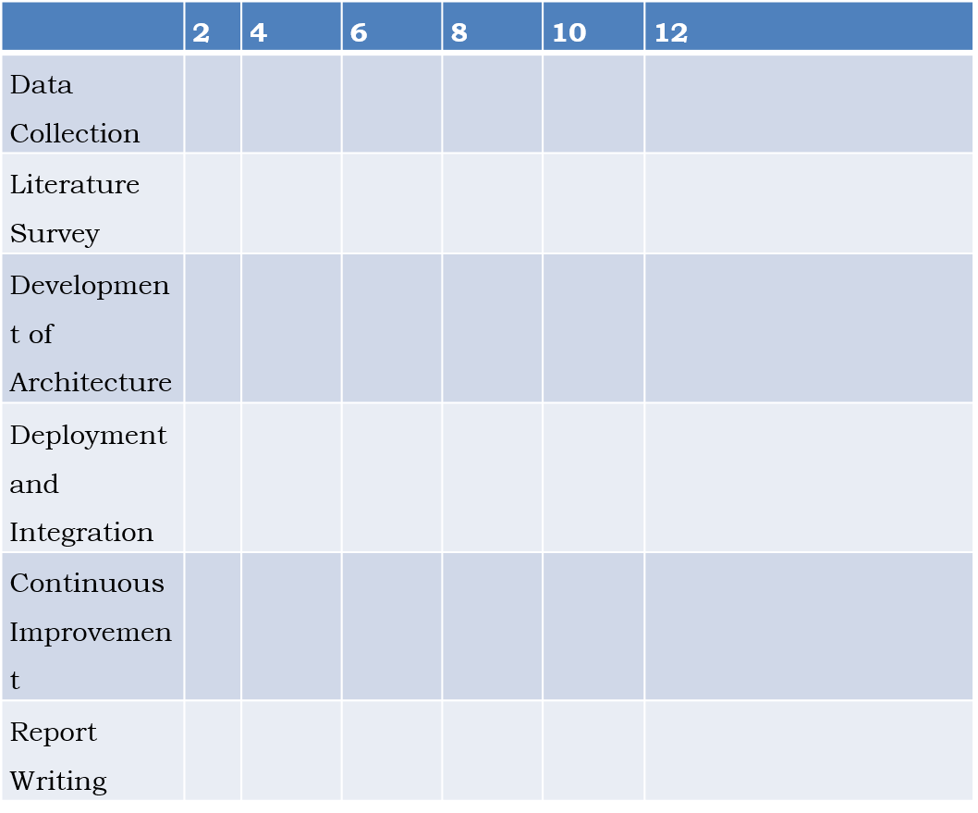

Slide 19
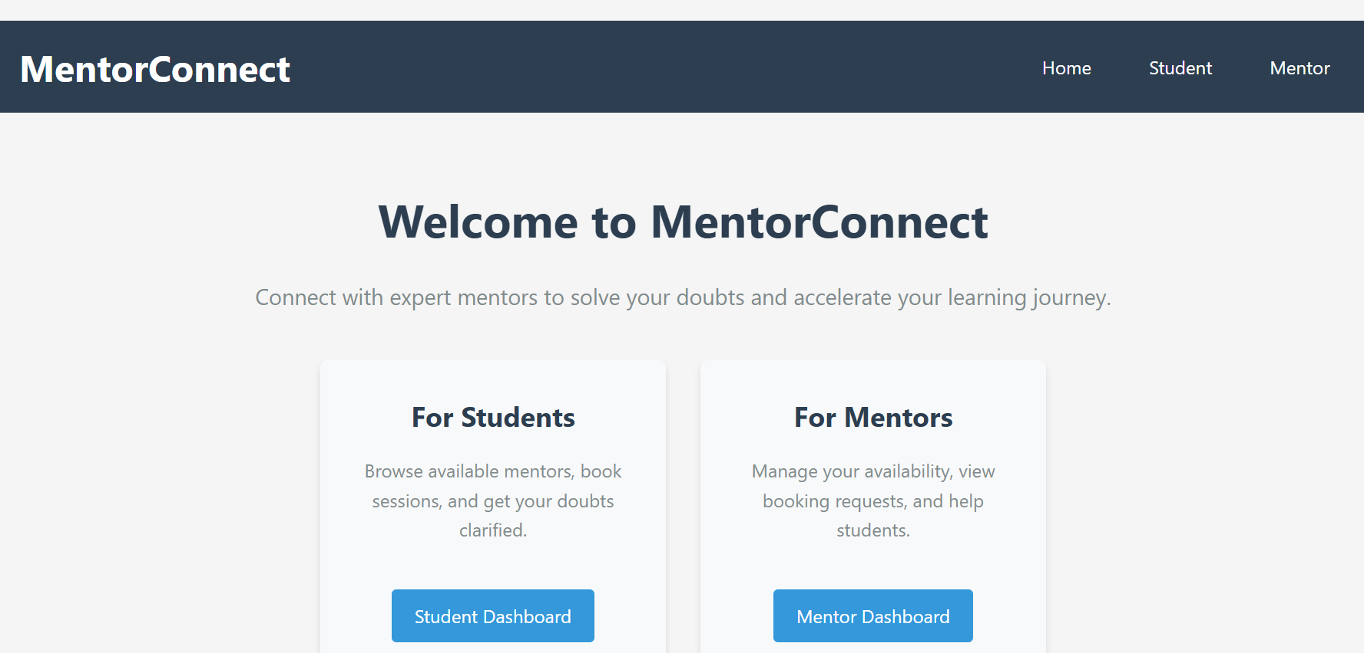

Slide 20
References
1.) Chiranmai, S. M. Rajesh, G. Meghana, S. Rose and N. Jayapandian, "Post Covid Scenario Effective E-Mentoring System in Higher Education," 2023 International Conference on Innovative Data Communication Technologies and Application (ICIDCA), Uttarakhand, India, 2023
2.) K. E. Holbert, L. L. Grable, A. Overbay and B. Nzekwe, "FREEDM ERC precollege programs: Motivating careers in the electric power industry," 2023 IEEE Power & Energy Society General Meeting, Vancouver, BC, Canada, 2024
3.) K. Trenshaw, D. Rushton, E. E. Miskioğlu and P. Asare, "Work-in-Progress: Emergent Themes from "High Impact" Role Model and Mentor Narratives," 2020 IEEE Frontiers in Education Conference (FIE), Uppsala, Sweden, 2022
4.) H. Vasquez, A. A. Fuentes and J. Mouhamad, "Mentoring in Lower-Level Engineering Courses," 2022 IEEE Frontiers in Education Conference (FIE), Covington, KY, USA, 2022, pp..
davji, N. M., Shah, A. P., & Davla, S. (2022). Building and sustaining mentor interactions as a mentee. The FEBS Journal, 289(6), 1374-1384.
10.) Online Mentoring: Programs and Practices" by Susan S. de Janusz and Shelley D. Godshalk

Slide 21
5.) J. Gadad, V. Talageri, P. Baligar and G. Joshi, "Peer-Mentoring in Design Projects in Project-Based Learning (PBL) at First-Year Engineering Course," 2021 IEEE Frontiers in Education Conference (FIE), Lincoln.
6.) C. Andrade, P. Alves, J. E. Fernandes and F. Coutinho, "A web platform to support mentoring programs in higher education," 2020 15th Iberian Conference on Information Systems and Technologies (CISTI), Seville, Spain, 2020.
7.) Author(s): Hafiz Iqbal,Subject(s): Education, Published by: Szkoła Główna Handlowa w Warszawie, Fundacja Promocji i Akredytacji Kierunków Ekonomicznych
8.) Alhadlaq, A., Kharrufa, A., & Olivier, P. (2022). Exploring e-mentoring: co-designing & un-platforming. Behaviour & Information Technology.
9.) Sarabipour, S., Hainer, S. J., Arslan, F. N., Furlong, E., Bielczyk, N

Slide 22


